Slide 1
Mental-2024 Proposed model
모바일시스템공학과
임석범, 이승재

Slide 2
0. Flow structure
Translate + Extraction
MisclassificatedSample
Attention Map

Slide 3
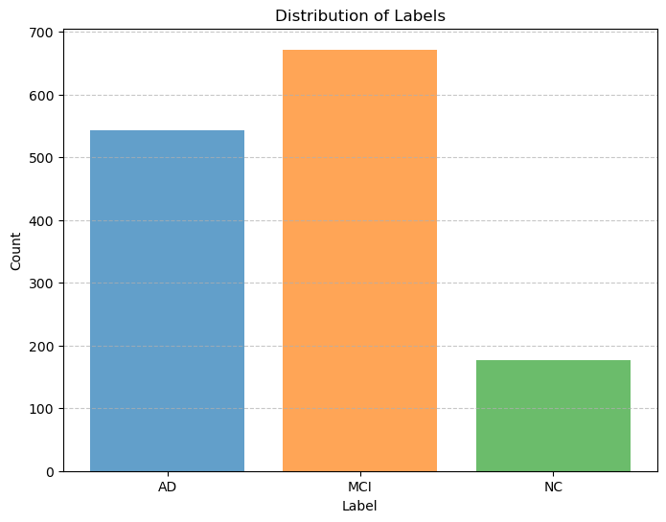
1. Data distribution - Number of patients with AD, MCI, and NC

Slide 4
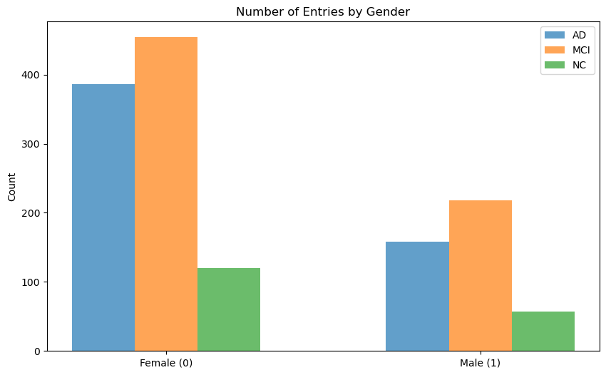
1. Data distribution - Number of AD, MCI, NC patients by gender

Slide 5
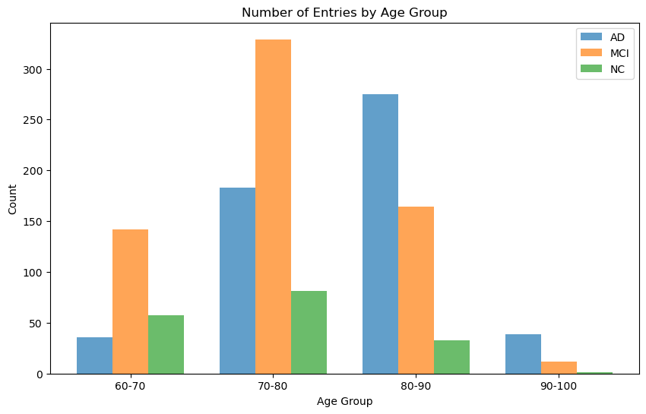
1. Data distribution - Number of AD, MCI, NC patients by Age

Slide 6
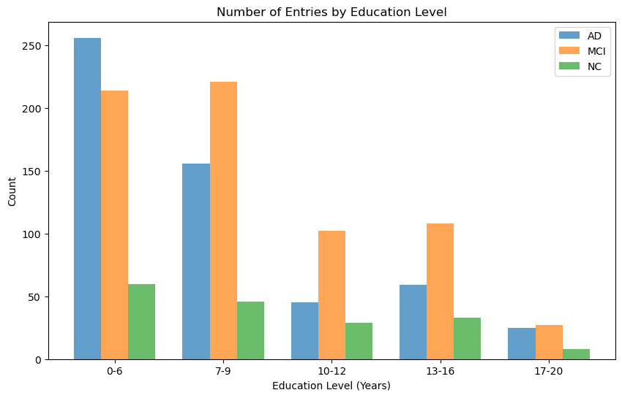
1. Data distribution - Number of AD, MCI, NC patients by Edu

Slide 7
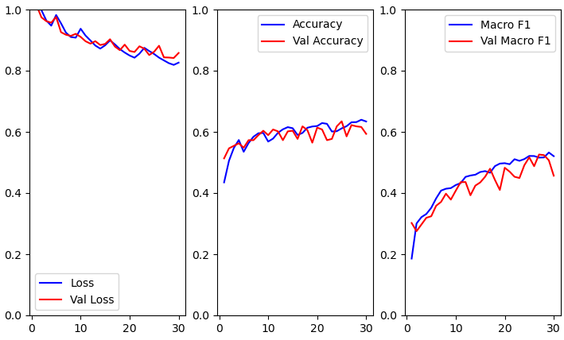
2. Data Results – Validation Loss(1)

Slide 8
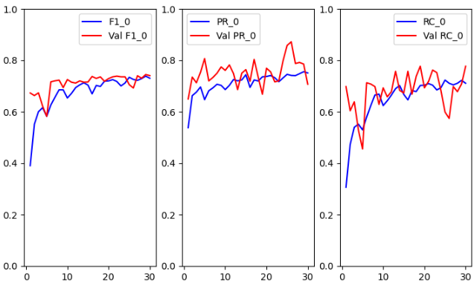
2. Data Results – Validation Loss(2)

Slide 9
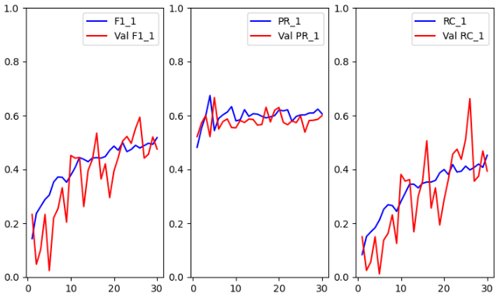
2. Data Results – Validation Loss(3)

Slide 10
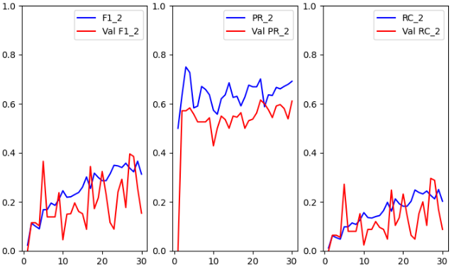
2. Data Results – Validation Loss(4)

Slide 11
2. 100 Epochs

